Slide 1
IMPACT OF CAR FEATURES
TRAINITY
MOGULAGANI PRASHANTH

Slide 2

PROJECT DESCRIPTION
The automotive industry is evolving rapidly, emphasizing fuel efficiency, sustainability, and innovation. To optimize pricing and product development decisions, analyze the relationship between car features, market categories, and pricing. Use techniques like regression analysis and market segmentation to balance consumer demand and profitability, guiding future product development and enhancing market competitiveness.

Slide 3
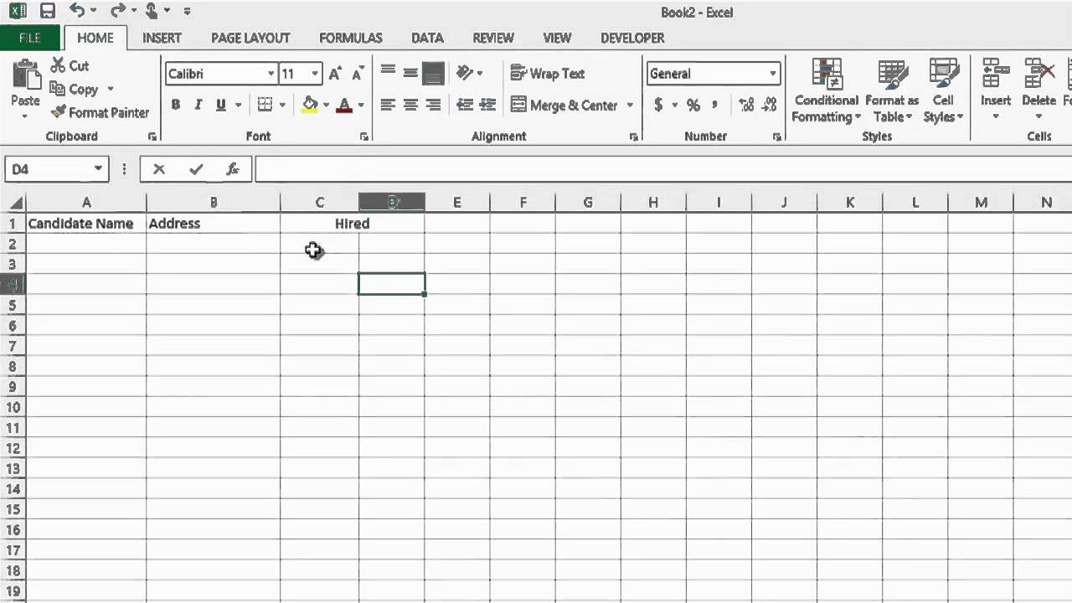

APPROACH
We are using MS excel to solve the problems.
Microsoft Excel is an application developed by Microsoft for Windows, macOS, Android, and iOS
We use MS excel formulas to analyze the solutions.

Slide 4
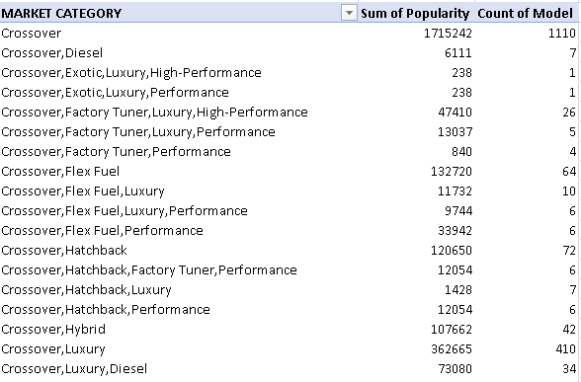
TASKS : ANALYSIS
Insight Required: How does the popularity of a car model vary across different market categories?
Task 1.A: Create a pivot table that shows the number of car models in each market category and their corresponding popularity scores.
INSIGHTS
Categorizes car models into market segments.
Shows the distribution of car models across market categories.
Highlights consumer preferences within each category through popularity scores.
Informs product development decisions and pricing strategies.
Supports competitive analysis based on market category data.

Slide 5
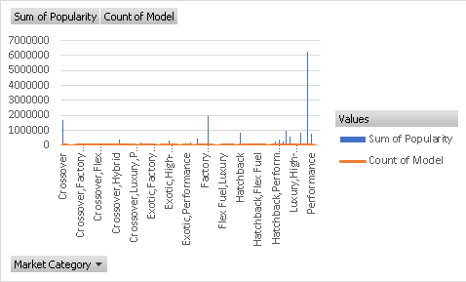
Task 1.B: Create a combo chart that visualizes the relationship between market category and popularity.
INSIGHTS:
Shows how market category and popularity are related visually.
Makes it easier to compare popularity scores across categories.
Supports the use of data to inform marketing and product development decisions.
Establishes competitive positioning within categories and potential market opportunities.

Slide 6
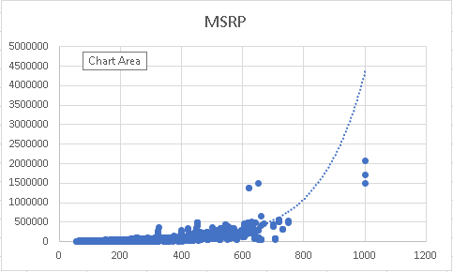
Insight Required: What is the relationship between a car's engine power and its price?
Task 2: Create a scatter chart that plots engine power on the x-axis and price on the y-axis. Add a trendline to the chart to visualize the relationship between these variables.
INSIGHTS
Positive Correlation: The rising trendline indicates a positive relationship between engine power and price.
Pricing Influence: Engine power likely has a significant impact on car prices, affecting pricing strategies.
Premium Positioning: Higher engine power may position cars as premium models with potential for higher pricing.
Competitive Edge: Understanding this correlation helps assess market competitiveness based on engine power and pricing.

Slide 7
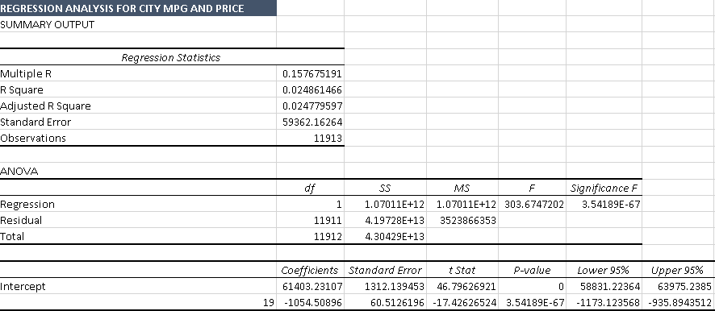
Insight Required: Which car features are most important in determining a car's price?
Task 3: Use regression analysis to identify the variables that have the strongest relationship with a car's price. Then create a bar chart that shows the coefficient values for each variable to visualize their relative importance.

Slide 8
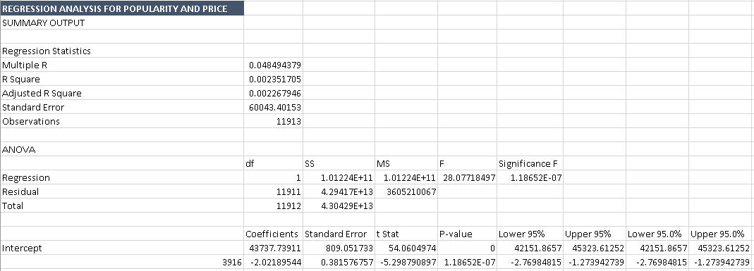

Slide 9
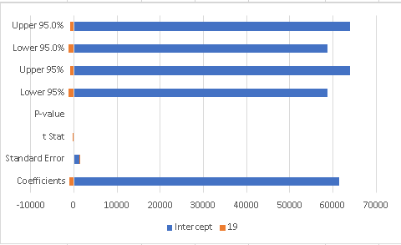
INSIGHTS
Variable Significance: Regression analysis identifies the most influential variables on car prices.
Quantified Relationships: Coefficient values in the bar chart quantify the strength of these relationships, aiding in variable prioritization.
Informed Decision-Making: Manufacturers can use this data to make informed decisions on pricing and product development.
Competitive Edge: Understanding key price determinants helps manufacturers position their cars competitively in the market.

Slide 10
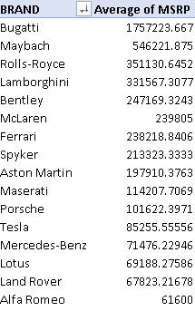
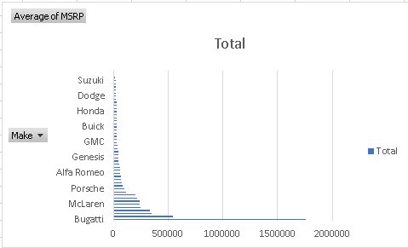
Insight Required: How does the average price of a car vary across different manufacturers?
Task 4.A: Create a pivot table that shows the average price of cars for each manufacturer.
Task 4.B: Create a bar chart or a horizontal stacked bar chart that visualizes the relationship between manufacturer and average price.
🚀 "Bugatti takes the crown with the highest average retail price in the market!" 💰👑

Slide 11
INSIGHTS
💰 Manufacturer Price Comparison: The pivot table allows for a quick comparison of average car prices among different manufacturers, revealing potential pricing disparities.
🏢 Market Positioning: Manufacturers can gauge their market positioning based on the average prices of their cars relative to competitors.
📊 Pricing Strategy: This data aids in developing or adjusting pricing strategies to align with market trends and consumer preferences.
🎯 Identifying Opportunities: Manufacturers can identify opportunities to optimize pricing and product offerings based on the average prices within the industry.

Slide 12

Insight Required: What is the relationship between fuel efficiency and the number of cylinders in a car's engine?
Task 5.A: Create a scatter plot with the number of cylinders on the x-axis and highway MPG on the y-axis. Then create a trendline on the scatter plot to visually estimate the slope of the relationship and assess its significance.
Task 5.B: Calculate the correlation coefficient between the number of cylinders and highway MPG to quantify the strength and direction of the relationship.
FORMULA USED

Slide 13
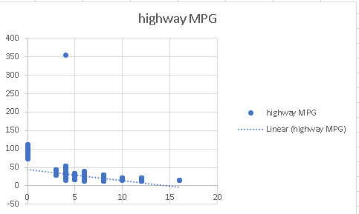
SCATTER PLOT

Slide 14
INSIGHTS
📈 Task 5A - Visual Insight: The dynamic scatter plot with a trendline allows us to visually grasp how the number of cylinders impacts highway MPG, providing an engaging exploration of the data.
🔍 Task 5B - Data Precision: Calculating the correlation coefficient gives us a precise, numeric measure of the strength and direction of the relationship. It's like having a "fuel efficiency score" for different engine configurations.
🚗💡 Design and Efficiency: These insights are essential for automakers to strike the right balance between engine power and fuel efficiency in their vehicle designs.
📊 Consumer Decision Support: Understanding this relationship helps consumers make informed choices when selecting vehicles based on their MPG preferences and engine configurations.
In summary, Tasks 5A and 5B provide both visual and numerical insights into the critical connection between the number of cylinders and highway MPG, benefiting both manufacturers and consumers in the automotive industry.

Slide 15
BUILDING THE DASHBOARDS
Now for the Next portion of the Project, we need to create the Interactive Dashboard.
We need to use filters and slicers to make the chart interactive. The client has requested these questions given below:
TASK 1
Task 1: How does the distribution of car prices vary by brand and body style?
Data Magic with Pivot Table: I'd whip up a Pivot Table to crunch the numbers, calculating total MSRP for each brand and body style.
Slick Slicers for Interaction: I'd add slicers to make the chart dynamic. Users can slice and dice data with a click.
Vivid Stacked Chart: Crafting a dynamic stacked column chart, where brand columns reveal body style segments, showcasing price distribution.
Insightful Exploration: Users play with slicers to unlock pricing insights, spotting trends and patterns with ease. 🚗💲

Slide 16
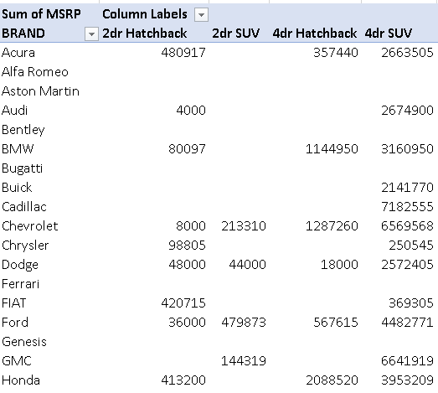
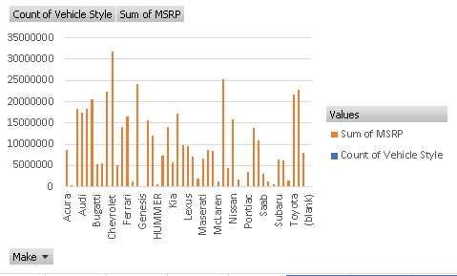
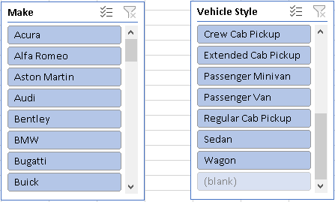

Slide 17
INSIGHTS
📊 Data Brilliance: Using a Pivot Table, I've crafted an insightful view of car prices by brand and body style.
🎯 Slicers Unleash Power: Interactive slicers put users in control, allowing them to explore pricing dynamics effortlessly.
🚗💰 Visual Price Story: The dynamic stacked chart visually narrates how prices unfold, empowering quick insights.
🔍 Analytical Playground: Users can dive in, uncovering trends and patterns with a click for smart decision-making.
SUMMARY
Interactive Pivot Table and slicers provide dynamic visuals, making pricing analysis effortless and insightful for users.

Slide 18
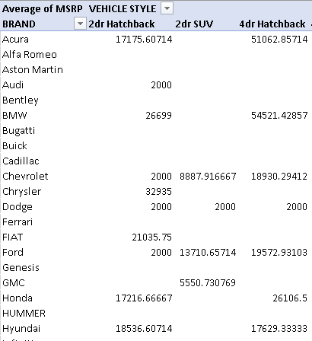
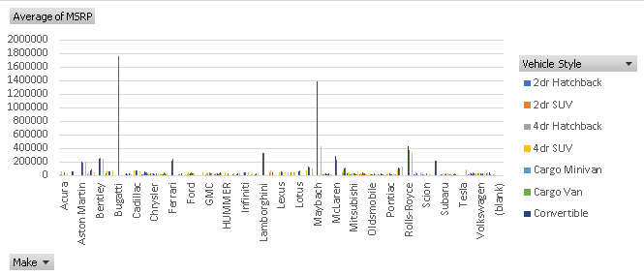
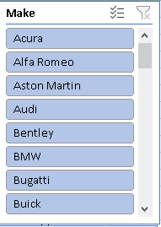
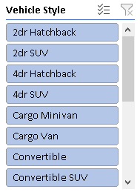
TASK 2
Task 2: Which car brands have the highest and lowest average MSRPs, and how does this vary by body style?

Slide 19
PROCESS
Prepared Data: Begin with your car data.
Utilized Pivot Tables: Employed Pivot Tables to compute average MSRPs by brand and body style.
Generated Dynamic Chart: Created an interactive chart for visual analysis.
Uncovered Insights: Discovered which brands command the highest and lowest average MSRPs and examined the variations across body styles. 🚗💰
INSIGHTS
💲 Price Variations: The analysis unveiled striking price disparities among car brands and body styles.
🚗 Brand Priciness: It pinpointed which car brands boast the loftiest and most budget-friendly average MSRPs.
👀 Body Style Impact: The data illuminated how your choice of body style within different brands can significantly influence car prices.
📊 Interactive Exploration: Dynamic charts empowered users to stylishly delve into and grasp these intriguing pricing dynamics. 💰

Slide 20
TASK 3
Task 3: How do the different feature such as transmission type affect the MSRP, and how does this vary by body style?
PROCESS
Data Prep: Start with your car data.
Pivot Power: Utilize Pivot Tables to analyze how different transmission types impact MSRP, considering variations by body style.
Slicers for Control: Incorporate interactive slicers for users to choose specific transmission types and body styles, customizing their analysis.
Pricing Patterns: Dive into the Pivot Table to uncover how transmission choices influence car prices within various body styles. 🚗💲

Slide 21
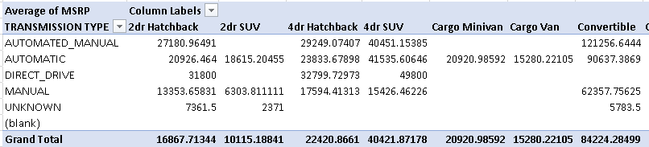
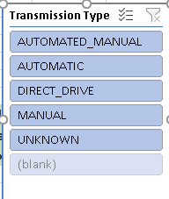
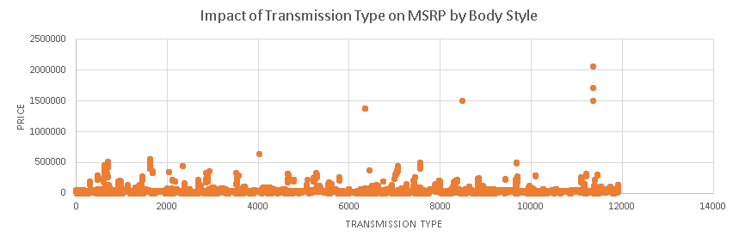

Slide 22
INSIGHTS
💲 Transmission Impact: The analysis elegantly unveils how various transmission types sway car prices (MSRP).
🚗 Body Style Variation: It vividly illustrates that the influence of transmission type on MSRP can dramatically shift across different car body styles.
🔍 Customized Exploration: With interactive slicers, users can stylishly tailor their analysis to delve into specific transmission types and body styles.
📊 Smart Decision-Making: These insights empower decision-makers to stylishly navigate transmission choices and their pricing dynamics within diverse body styles. 💰🚗

Slide 23
TASK 4
Task 4: How does the fuel efficiency of cars vary across different body styles and model years?
PROCESS
📈 Data Prep: Begin with your car data.
🔄 Pivot Mastery: Leverage Pivot Tables to expertly dissect fuel efficiency variations across diverse body styles and model years.
🔍 Slicers for Precision: Introduce interactive slicers, giving users the stylish ability to fine-tune their analysis.
🚗💨 Fuel Efficiency Insights: Explore the Pivot Table to uncover elegant patterns in car fuel efficiency, tied to body styles and model years.

Slide 24
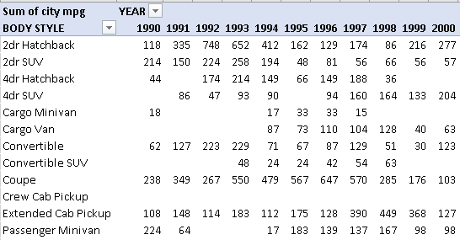
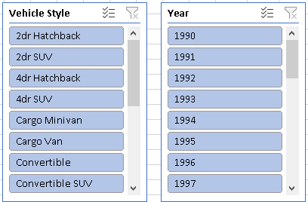
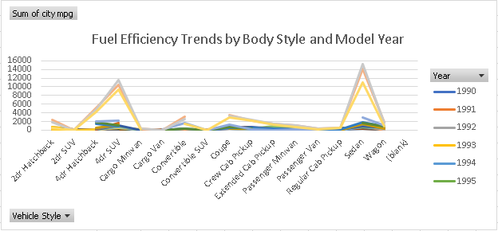

Slide 25
INSIGHTS
💨 Fuel Efficiency Variations: The analysis elegantly uncovers the spectrum of fuel efficiency (MPG) across diverse car body styles and model years.
📊 Dynamic Chart: The insights are beautifully visualized in a dynamic chart, allowing users to grasp trends in fuel efficiency effortlessly.
⏳ Trends Over Time: The chart stylishly depicts how fuel efficiency has evolved across different model years, offering a journey through automotive progress.
🚗 Body Style Impact: It vividly showcases how different body styles influence fuel efficiency, empowering consumers and manufacturers with knowledge for savvy choices and design decisions.

Slide 26
TASK 1
Task 5: How does the car's horsepower, MPG, and price vary across different Brands?
PROCESS
📊 Data Prep: Begin with your car data.
🔄 Pivot Mastery: Skillfully employ Pivot Tables to dissect variations in horsepower, MPG, and price across diverse car brands.
📈 Bubble Chart Brilliance: Transforming insights into an engaging Bubble Chart, where each bubble represents a brand, and its size and position elegantly visualize how horsepower, MPG, and price interact, offering a comprehensive view.
🔍 Interactive Exploration: With slicers, users gain the stylish ability to fine-tune their analysis, diving deep into the bubble chart for brand-specific insights.
🚗🏁💰 Brand Insights: Delve into the Pivot Table and Bubble Chart to reveal how car attributes evolve across different brands, providing valuable information for informed decisions.

Slide 27
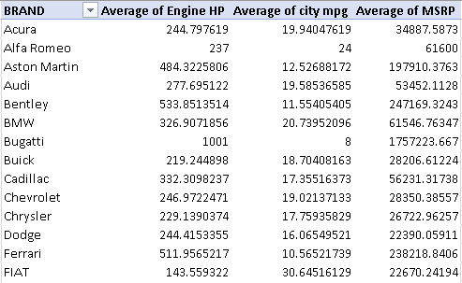
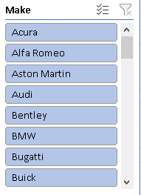
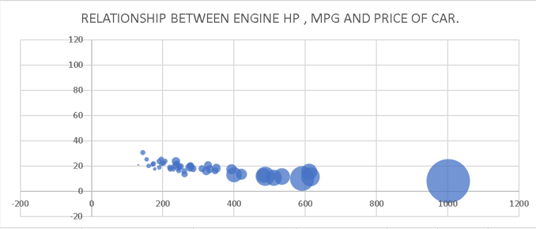

Slide 28
INSIGHTS
📊 Performance vs. Efficiency: The analysis reveals a trade-off between horsepower and MPG across car brands, beautifully represented in the engaging Bubble Chart.
💰 Price Range: Different brands offer a wide range of prices, elegantly visualized within the same chart.
🚗 Brand Attributes: It highlights how each brand's unique attributes in terms of horsepower, MPG, and price contribute to its distinct market positioning.
🔍 Visual Understanding: The Bubble Chart not only provides insights but also engages users, making it easier for them to grasp the complex interplay between these attributes in a single glance. 🏁🚗💡

Slide 29
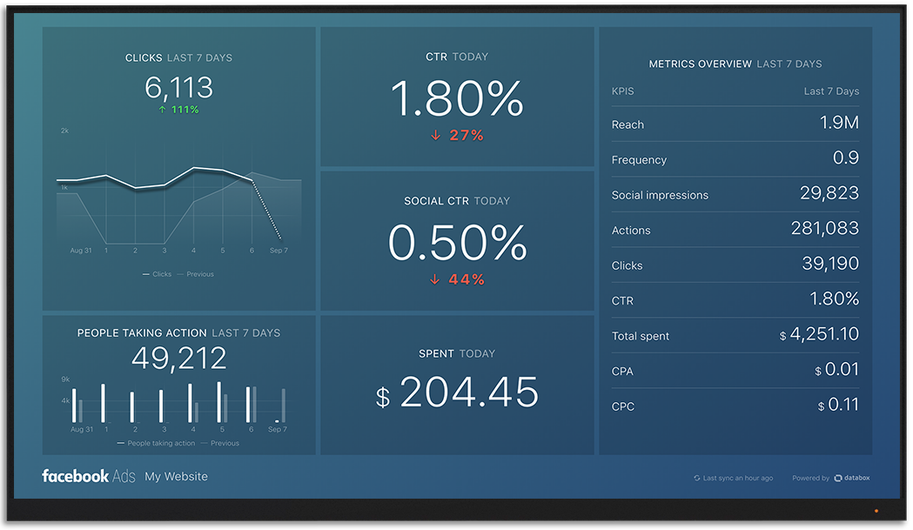
RESULT
I became acquainted with new EXCEL features, lingo, and methods. By obtaining the appropriate insights from the problem description, practical problems can be resolved. Thanks to the concepts, I was able to comprehend the description of the problem. This project has improved my problem-solving skills and taught me how to apply the theoretical concepts I learned in training to actual-world circumstances.
LINK FOR EXCEL FILE
https://docs.google.com/spreadsheets/d/1CY0sP2DtBNcfkHOHew2hNAZZ8gCxmA6B/edit?usp=drive_link&ouid=108547673521600619650&rtpof=true&sd=true

